Slide 1
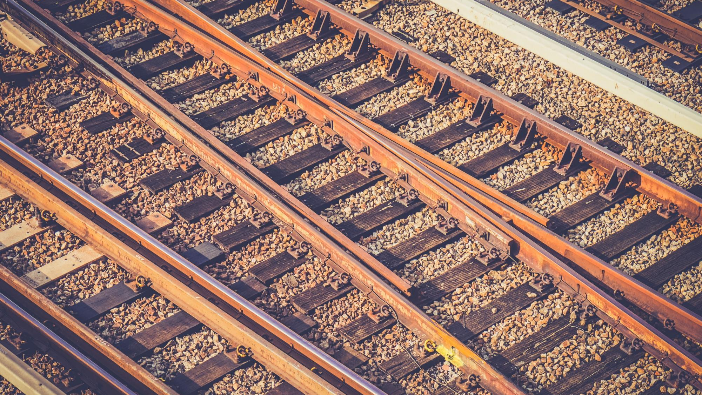
SMART RAIL
Smart India Hackathon - 2018
Black Caps
Notes:
To use this title animation slide with a new image simply 1) move the top semi-transparent shape to the side, 2) delete placeholder image, 3) click on the picture icon to add a new picture, 4) Move semi-transparent shape back to original position, 5) Update text on slide.

Slide 2
SMART INDIA WANTS A SMART RAIL
WHY
?
Railway has a lot to offer, but still struggling to deliver its full potential.
Traditional and Outdated Approach
The Huge Information Gap
Lack of an Integrated Service Platform

Slide 3
OUR AIM
Digitalization of the Railway Services
Bridge the information gap
WE WANT TO POWER THE ENGINE OF INDIA
Virtual Guide of the passengers
Self-evolving Community Framework

Slide 4
HOW
?
Before you board your train.
While you are on your train.
After you get off your train.

Slide 5
Before
Before your board your train
“Get”
Plan your journey.
“Set”
Use your experience to help others out. Answer queries and get yours answered too.
“Travel Diary”
Blog your experience or just maintain your personal memories in a digital diary.

Slide 6
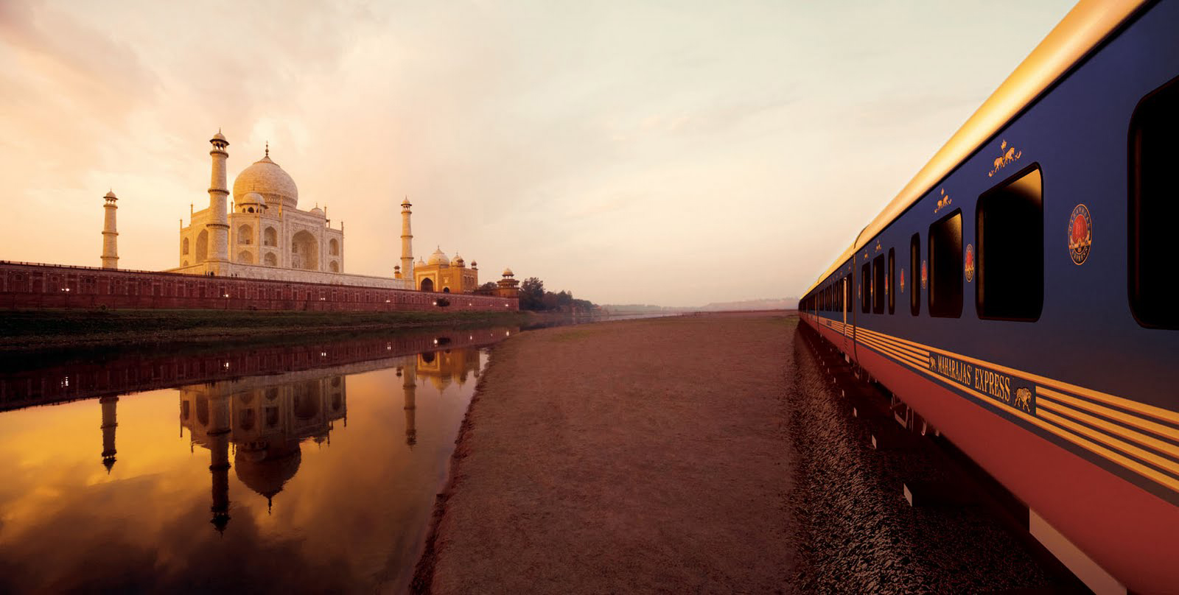
Your guide to all 5-steps of the journey
Avail the various railway services.
Journey Planning
Visit the railway station.
Board on your train.
Arrival at your destination.
1
2
3
4
5
Learn from the experience of others.
Get digital, mark yourself online.
Reach the services from your phone.
Accompanied by your virtual assistant.
Give your feedback and suggestions.

Slide 7
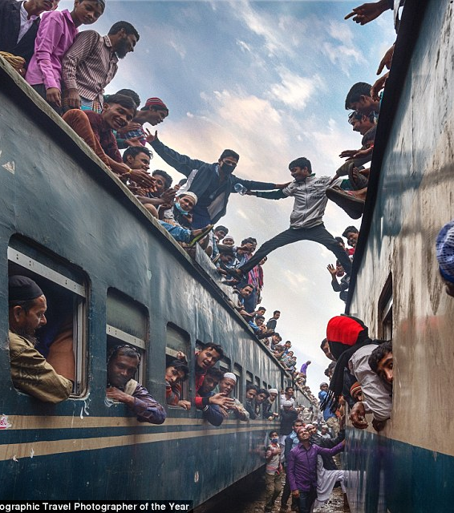
1
Plan your journey
Past experience of the passengers.
Their feedback and suggestions.
Using sophisticated algorithms.
Your past preferences.
Current Trend.

Slide 8
2
Digital presence at the station.
Digital enquiry window.
Real time announcements.
Avail passenger services on the go.
Navigate in and around the premises.
Make railways clean using ‘Digital Safai’.

Slide 9
3
Digital railway services
Online reservations.
Make online complaints.
Booking pantry food online.
Order food from food joints.
Real time notifications on mobile.

Slide 10
4
Virtual travel assistance
Navigate to your seat.
Book food from your seat.
Know your fellow companions.
Platform No. and side upon arrival.
Navigate to the exit and help find taxi.

Slide 11
5
Help railways grow
Give your feedback and suggestions.
Rate the services on 1 to 5 scale.
Blog and share your experience.
Help others in forum.
Become an active community member.

Slide 12

ALONE WE CAN DO SO LITTLE,
TOGETHER WE CAN DO SO MUCH.
YOUR SUPPORT IS ALL WHAT RAILWAY NEEDS.
—HELEN KELLER

Slide 13
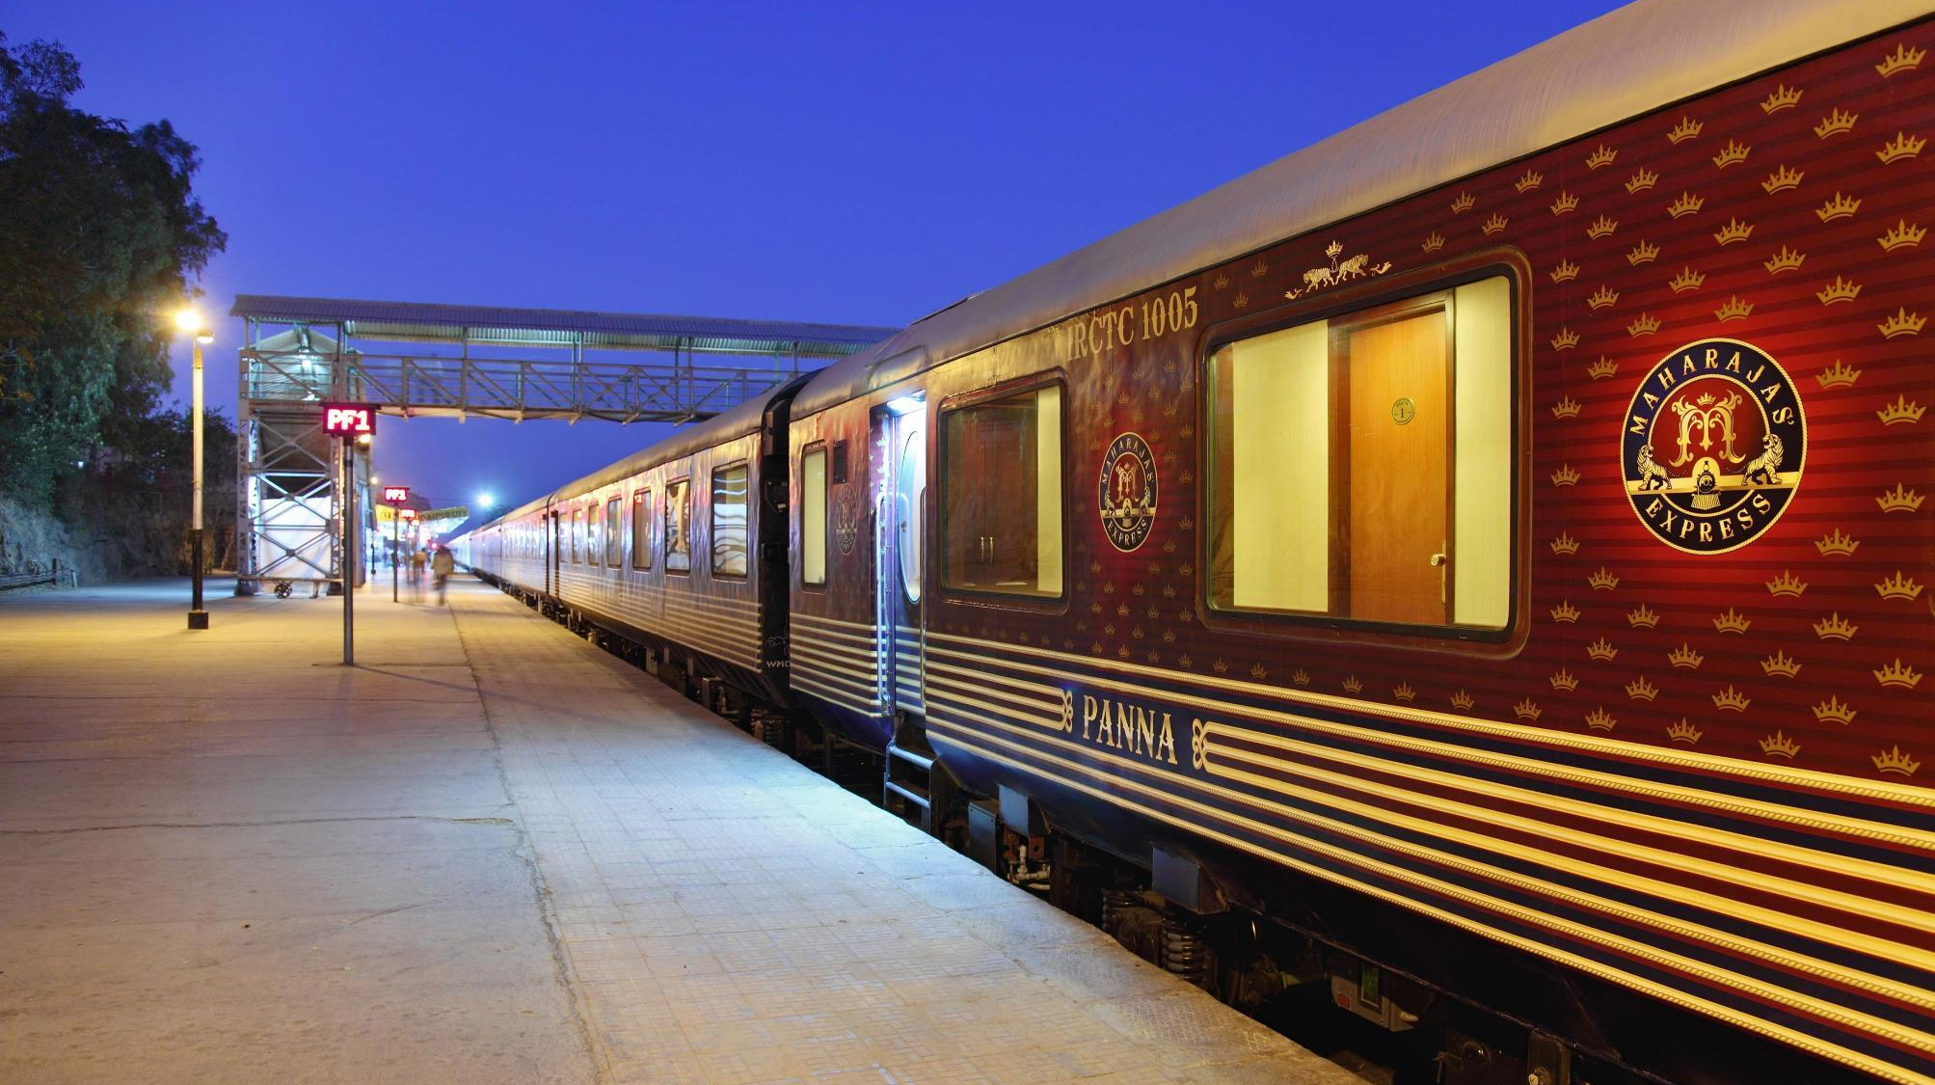
3
Images are a great tool for showing context
SUPPORT
We perceive the world through more than our eyes and ears; we smell, we touch, and we taste.
Put your audience in that place and provide them a point of reference; the imagination will do the rest.
Notes:
Tip:
When using complex image as full-bleed background add a transparency (70%-90%) fill layer to give contrast to text.

Slide 14
VISUALS ADD A COMPONENT TO STORYTELLING THAT TEXT CANNOT | SPEED.
FUTURE
Images are another element that can drive your point home even more

Slide 15
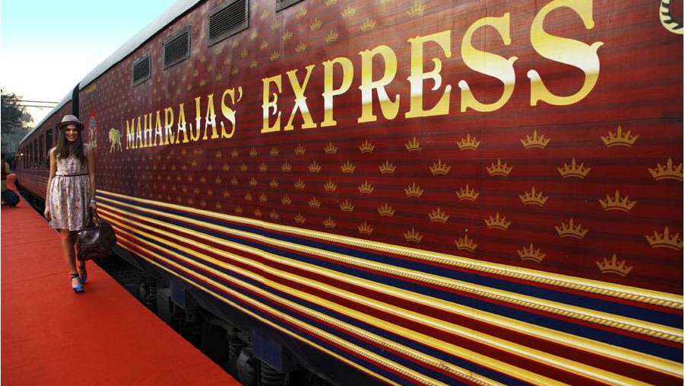
HAVE AN AWESOME DAY!
THANK YOU

Slide 16
“THE INDIAN RAILWAYS WILL BECOME THE GROWTH ENGINE OF NATION’S ‘VIKASH YATRA’”.
—NARENDRA MODI, PRIME MINISTER OF INDIA

